Slide 1

Innovation and
Technology:
Shaping
Our
Future
PMVTC Library Department
Date: August 11, 2026

Slide 2
What is
Innovation?
Definition
Innovation is the process of creating new ideas, products, or methods that add value or solve problems.
At its core, innovation transforms creative thinking into real-world impact reshaping industries, improving lives, and driving progress across every field of human endeavor.
Key aspects of innovation:
• Value Creation: Innovation generates new solutions that address unmet needs and improve existing processes.
• Driver of Progress: It fuels economic growth, technological advancement, and societal change.
• Continuous Change: Innovation is not a single event but an ongoing cycle of ideation, experimentation, and improvement.
• Problem Solving: From healthcare to energy, innovation tackles the world's most complex challenges with fresh perspectives.
Innovation is what separates the future from the past.

Slide 3
Technology?
What is
Definition
Technology is the application of scientific knowledge for practical purposes, especially in industry and everyday life.
At its core, technology encompasses the tools, systems, machines, and devices that extend human capabilities enabling us to do more, faster, and with greater precision than ever before.
From the wheel to the internet, technology has always been the bridge between human ingenuity and real-world impact. Today, it powers communication, healthcare, transportation, education, and virtually every aspect of modern life.
Key Dimensions of technology:
• Tools and devices that amplify human ability
• Systems and networks connecting people and information
• Digital platforms enabling global collaboration
• Automation and AI transforming industries
Technology does not exist in isolation it is shaped by human needs, scientific discovery, and societal values, evolving continuously to meet the challenges of our time.

Slide 4
Why Innovation
and Technology
Matter
Economic Growth
Quality of Life
Innovation and technology drive economic growth, boost competitiveness, and create new markets and industries worldwide.
Technology improves healthcare, education, and daily living, helping solve pressing global challenges like climate change and disease.
New Industries & Opportunities
Global R&D investment surpassed $3 trillion in 2025, reflecting a growing worldwide focus on innovation and technological advancement.

Slide 5
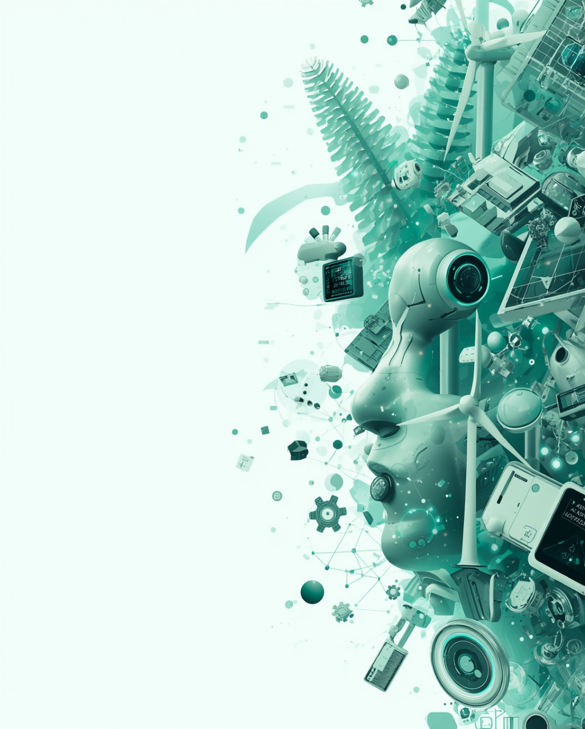
Examples of Modern
Technologies
Shaping Our World
AI & Machine Learning
Robotics & Automation
Artificial Intelligence enables machines to learn, reason, and make decisions — transforming industries from healthcare to finance.
Advanced robotics and automation streamline manufacturing, logistics, and services, boosting efficiency and precision.
Renewable Energy & IoT
Solar, wind technologies and Internet of Things devices are creating smarter, cleaner, and more connected environments.

Slide 6

Technology
Challenges of
Ethics & Privacy
Workforce Disruption
Access & Regulation
Emerging technologies raise serious ethical concerns and risks to personal privacy, requiring careful governance and transparent data practices.
Automation and AI are displacing jobs and reshaping industries, demanding new skills and adaptive workforce strategies.
High costs limit equal access to technology, while its rapid pace of change makes effective regulation and policy-making increasingly difficult.

Slide 7
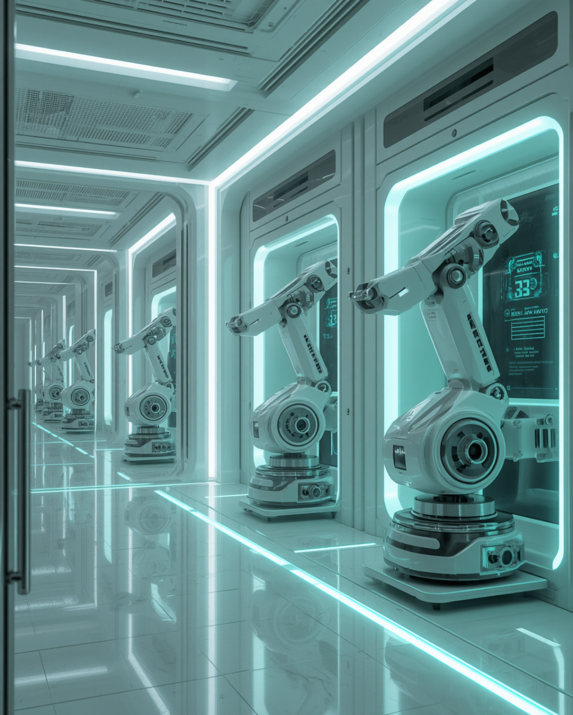
Key Innovations Transforming
the
World
Artificial Intelligence
Renewable Energy
AI is revolutionizing decision-making across industries, enabling smarter automation, predictive analytics, and intelligent systems.
Solar, wind, and clean energy technologies are driving global sustainability and reducing dependence on fossil fuels.
Biotechnology & Advanced Robotics
Biotechnology enables life-saving medical breakthroughs, while advanced robotics enhances precision in manufacturing, healthcare, and services.

Slide 8

Benefits and Challenges
Innovation
Efficiency & Sustainability
Economic Benefits
Key Challenges
Drives economic growth and creates new industries. Improves healthcare outcomes and living standards for communities worldwide.
Increases productivity and operational efficiency. Enables sustainable solutions for energy, environment, and resource management.
Ethical dilemmas and privacy concerns. Workforce disruption due to automation. Unequal access and growing digital divides.

Slide 9

Looking Ahead:
The Future of Innovation and Technology
"The best way to predict the future is to invent it." – Alan Kay
Continued innovation and responsible technology use will shape a smarter, more connected world.

