Slide 1
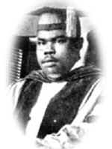
HIS EARLY LIFE
Born in St. Ann's Bay, Jamaica, on August 17, 1887, Marcus Garvey was the youngest of 11 children. His father was a stone mason, and his mother, a domestic worker, from a family of small farmers. He was baptized in the local Methodist Church and attended infant and elementary schools in St. Ann's Bay. Garvey moved to Kingston at the age of 14 and later found work in the print shop of Mr. Burrowes located on main street, St. Anns Bay.

Slide 2
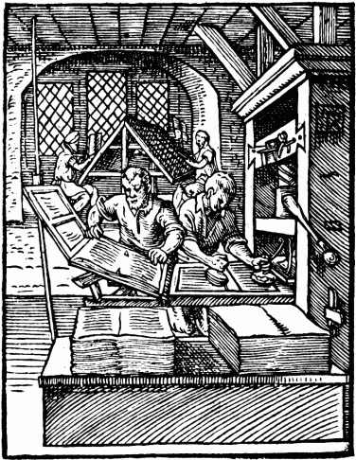
Garvey then moved to Port Maria, St. Mary, where he lived with relatives and worked at a printery and became au fait (being fully informed, well-versed) with the appalling living conditions of the labouring class. After this he relocated to Kingston in 1906. In Kingston, Garvey found work in the printing department at P.A. Benjamin Manufacturing Company. Although young he was rapidly promoted and was made master printer and foreman.
He quickly involved himself in social reform, participating in the first Printers' Union strike in Jamaica in 1907 and in setting up the newspaper The Watchman.
Source: http://www.swagga.com/marcus.htm

Slide 3
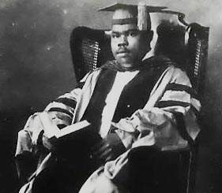
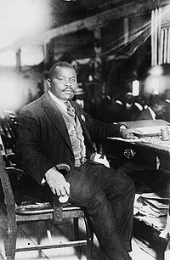
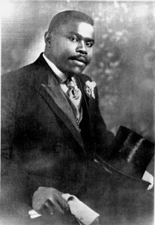
HIS EARLY TRAVELS
Garvey left Jamaica in 1910, like many others at the time in search of better wages. His main plan at the time was to earn money to finance his projects. He visited Central and South America, gathering evidence that black people everywhere were victims of unfairness.

Slide 4
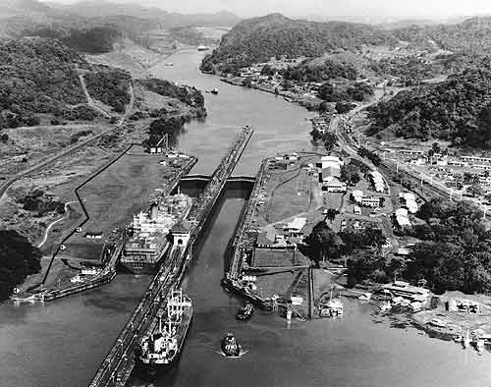
HIS EARLY TRAVELS Cont’d
He visited the Panama Canal Zone and saw the conditions under which the West Indians lived and worked. He went to other places such as: Ecuador, Nicaragua, Honduras, Colombia and Venezuela. It was even more evident that blacks everywhere were experiencing great hardships.

Slide 5
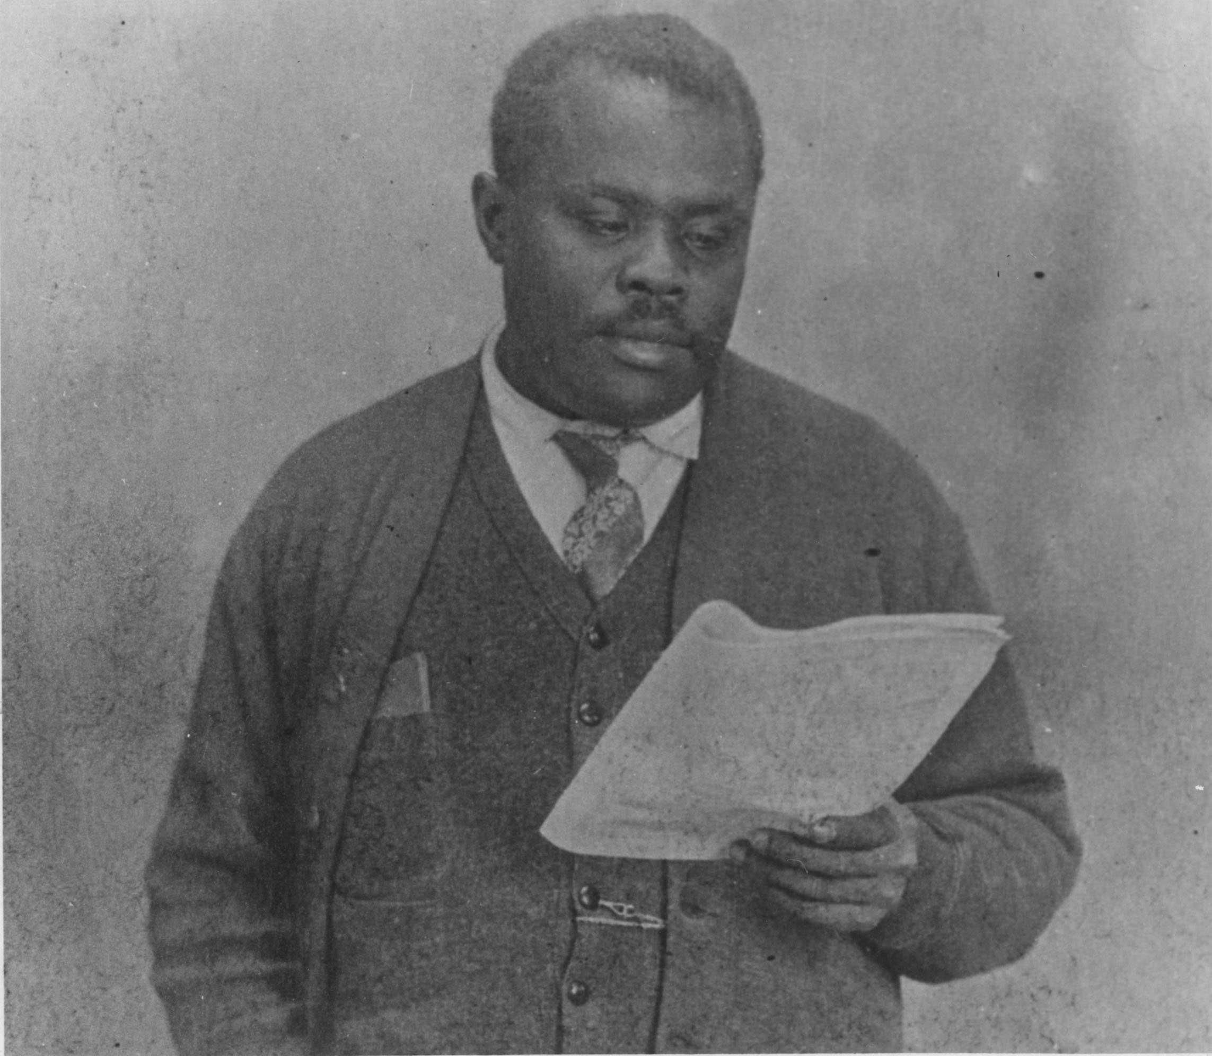
HIS EARLY TRAVELS Cont’d
Upon his return to Jamaica, he was very distressed at the situation in Central America, and appealed to Jamaica's colonial government to help improve the plight of West Indian workers in Central America. His appeal fell on deaf ears. These experiences, however made Garvey more adamant. He began to lay the groundwork of the Universal
Negro Improvement Association,
to which he was to devote his life..
Garvey advocated for the workers rights. In Cost Rica he did this through the newspaper “La Nacion” which he edited.

Slide 6
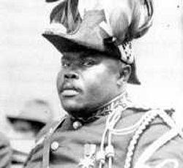
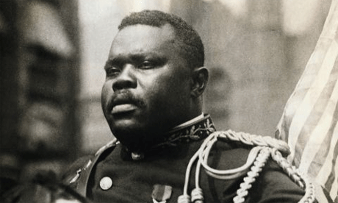
HIS LIFE Cont’d
Undaunted by lack of enthusiasm for his plans, Garvey left for England in 1912 in search of additional financial backing. He met a Sudanese-Egyptian journalist, Duse Mohammed Ali, while in England and began working for Ali's publication African Times and Oriental Review. During this time, Garvey began to study the history of Africa, particularly, the exploitation of black peoples by colonial powers. He read Booker T. Washington's Up From Slavery, which advocated black self-help.

Slide 7
THE UNIVERSAL NEGRO
IMPROVEMENT ASSOCIATION (UNIA)
After he returned to Jamaica, Garvey with the help of an associate, Enos J. Sloly and about four others established the Universal Negro Improvement Association (U.N.I.A.) and African Communities League (ACL) on Emancipation Day, August 1, 1914.
The motto “One God, One Aim, One Destiny” was adopted. Some of the general objectives were:
  to establish an association of
  individuals among the race
  united with the common
  purpose of elevating black
  people;
  to promote the spirit of race,
  pride and love; to administer
  to and assist the needy;
  to establish Commissionaires or
  Agencies in the principal countries of
  the world for the protection of all
  Negroes, irrespective of nationality;
  to establish universities, colleges, and
  secondary schools for further
  education of black people.

Slide 8
THE UNIVERSAL NEGRO IMPROVEMENT ASSOCIATION (UNIA) Cont’d
The first convention was held in the 1920’s in New York . It opened with a parade down Harlem's Lenox Avenue. That evening, before a crowd of 25,000, Garvey outlined his plan to build an African nation-state. In New York City his ideas attracted popular support, and thousands enrolled in the UNIA. He began publishing the newspaper The Negro World and toured the United States preaching black nationalism to popular audiences. Between 1916 and 1927, the UNIA grew to become the largest Pan-African organization in history.

Slide 9
THE UNIVERSAL NEGRO
IMPROVEMENT ASSOCIATION (UNIA) Cont’d
His efforts were successful, and soon, the association boasted over 1,100 branches in more than 40 countries. Most of these branches were located in the United States, which had become the UNIA's base of operations. There were, however, offices in several Caribbean countries -Cuba having the most. Branches also existed in places such as Panama, Costa Rica, Ecuador, Venezuela, Ghana, Sierra Leone, Liberia, Namibia and South Africa. He also launched some ambitious business ventures, notably the Black Star Shipping Line.

Slide 10

THE UNIVERSAL NEGRO
IMPROVEMENT ASSOCIATION (UNIA) Cont’d
In the years following the organization's first convention, the UNIA began to decline in popularity. With the Black Star Line in serious financial difficulties, Garvey promoted two new business organizations — the African Communities League and the Negro Factories Corporation. He also tried to reclaim his colonization scheme by sending a designated group to appeal to the League of Nations for transfer to the UNIA of the African colonies taken from Germany during World War I.

Slide 11
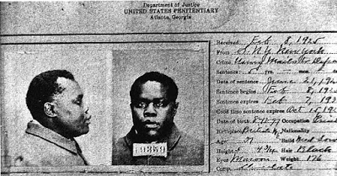
GARVEY'S IMPRISONMENT
Financial betrayal by trusted aides and a host of legal entanglements (based on charges that he had used the U.S. mail to defraud prospective investors) eventually led to Garvey's imprisonment in Atlanta Federal Penitentiary for a five-year term. In 1927 his half-served sentence was commuted, and he was deported to Jamaica by order of President Calvin Coolidge.
Source:http://2.bp.blogspot.com/-CQPLvneH2QY/UHQuSbtnj_I/AAAAAAAAGmo/19QK40-yFnY/s400/Marcus+garvey+Prison+001.jpg

Slide 12
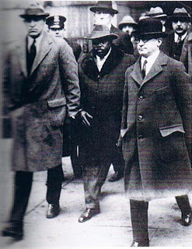
GARVEY'S IMPRISONMENT Cont’d
Garvey then turned his energies to Jamaican politics, campaigning on a platform of self-government, minimum wage laws, and land and judicial reform. He was soundly defeated at the polls, however, because most of his followers did not have the necessary voting qualifications.

Slide 13
GARVEY RETURN TO ENGLAND
By 1935 Garvey made the decision to relocate to London, England, in an effort to rebuild the influence of the UNIA. Additionally, financial problems had resulted in the loss of his printing press, Edelweiss Park and his family home. In London Garvey founded the School of African Philosophy in 1937 to train future officials of the UNIA.
Suffering from asthma and bronchitis Garvey’s health began to fail in the cold London weather. He had a stroke in January 1940. In May of that year an article was published that Garvey had died which caused him great distress. He suffered a second stroke and lapsed into a coma. Garvey died on June 10, 1940, and was interred in the Kendal Green Cemetery, London.

Slide 14
GARVEY’S LEGACY
Garvey influenced black leaders in several countries. Persons such as Jomo Kenyatta, Pan-Africanist and first president of Kenya and Kwame Nkrumah, first president of independent Ghana, testified to the influence which Garvey had on them. Nkrumah’s tribute to Garvey was symbolized by the inclusion of Garvey’s black star insignia in the new flag of the free Republic of Ghana. Malcolm X, Black Nationalist and a leader of the U.S. Civil Rights Movement proclaimed that it was “… Marcus Garvey’s philosophy of Pan-Africanism that initiated the entire freedom movement …”
Garvey supported the independence movement of India and Ireland. He inspirited Ho Chi Minh, father of Vietnam independence. Garvey’s words have also resonated with the Aborigines of Australia.

Slide 15
GARVEY’S LEGACY Cont’d
His teachings influenced the Rastafarian movement. Leonard Howell and Robert Hinds, two of the founders of the Rastafarian movement, were once UNIA members. The coronation of Haile Selassie in Ethiopia was perceived by many Rastafarians to have been the fulfillment of a Garvey prophecy concerning the coming of an African King.
Garvey also has an inspiring influence on Jamaican music. Burning Spear (Winston Rodney) and the late Robert Nesta Marley were the main reggae emissaries to disseminate Garvey’s message. Marley was one of the most potent messengers for Garvey’s “Africa for Africans” message.
Garvey’s legacy has endured through the increase in racial pride among black people, the emphasis on education as the key to self reliance and economic development for the advancement of the race.

Slide 16
MARCUS GARVEY - NATIONAL HERO
World-wide Marcus Garvey has been immortalized in several ways:
Schools, colleges, highways and buildings in Africa,
Europe, the Caribbean and the United States have been
named for Garvey;
The UNIA’s red, black and green flag was adopted as the Black Liberation
flag;
A bust of Garvey was unveiled at the Organization of American States’ Hall
of the Americas, in 1980.
Jamaica has honoured Garvey as well:
A bust was placed in the George VI Park (now National Heroes Park) in 1956; In November 1964 the Jamaican Government brought Garvey’s body home from London and buried it in a shrine erected in his honour in National Heroes Park; He was the first named Jamaican National Hero;

Slide 17
MARCUS GARVEY - NATIONAL HERO Cont’d
In 1968, the Jamaican government offered a prize in the name of Marcus Garvey to observe the International Human Rights Year. This was awarded posthumously to Martin Luther King Jnr.; A scholarship has been named in his honour; Marcus Garvey Technical High School in St. Ann, Garvey Maceo High School in Clarendon and a highway in Kingston all bear his name. Jamaica’s Fifty Cents coin carries his image; In 1973, the first International Seminar on Marcus Garvey was held in Kingston; A life-sized statue of him, sculpted by Alvin Marriot and unveiled in 1976, stands in front of the St. Ann Parish Library in Lawrence Park, St. Ann’s Bay; His birthday is observed annually as a civic reception in St. Ann’s Bay; In 1978 the Ministry of Foreign Affairs Building was renamed the Marcus Garvey Building; Many Jamaican poets have written about Garvey and his name appears in several songs composed by reggae artistes.

Slide 18
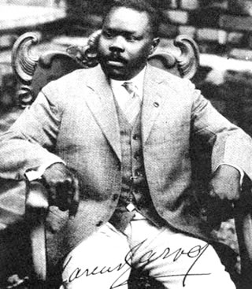
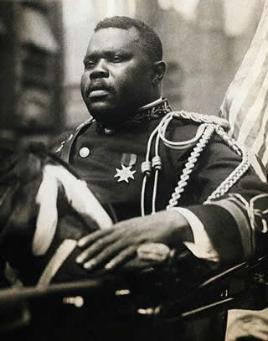
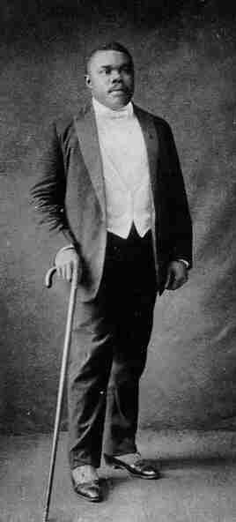
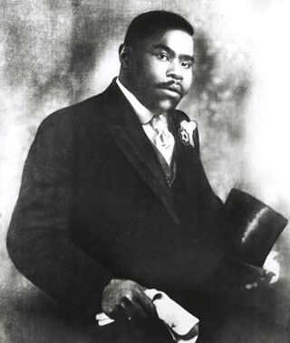
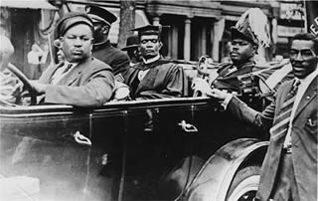

Slide 19
QUOTES FROM MARCUS GARVEY
A people without the knowledge of their past history, origin and culture is like a tree without roots.
With confidence, you have won before you have started.
The Black skin is not a badge of shame, but rather a glorious symbol of national greatness.
Liberate the minds of men and ultimately you will liberate the bodies of men.
God and Nature first made us what we are, and then out of our own created genius we make ourselves what we want to be. Follow always that great law. Let the sky and God be our limit and Eternity our measurement.
Our success educationally, industrially and politically is based upon the protection of a nation founded by ourselves. And the nation can be nowhere else but in Africa.

Slide 20
Exhibition Reference List
1. National Library of Jamaica. Marcus Mosiah Garvey Biography. https://nlj.gov.jm
2. Jamaica Information Service (JIS). Marcus Garvey: National Hero. https://jis.gov.jm
3. Encyclopaedia Britannica. Marcus Garvey. https://www.britannica.com/biography/Marcus-Garvey
4. UCLA. The Marcus Garvey and UNIA Papers Project. https://www.international.ucla.edu/garvey
5. PBS American Experience. Marcus Garvey. https://www.pbs.org
Garvey, Amy Jacques (Ed.). The Philosophy and Opinions of Marcus Garvey.
6. National Archives and Records Administration (USA). Records relating to Marcus Garvey.
7. UNESCO. Resources on Pan-Africanism and Marcus Garvey.

