Slide 1
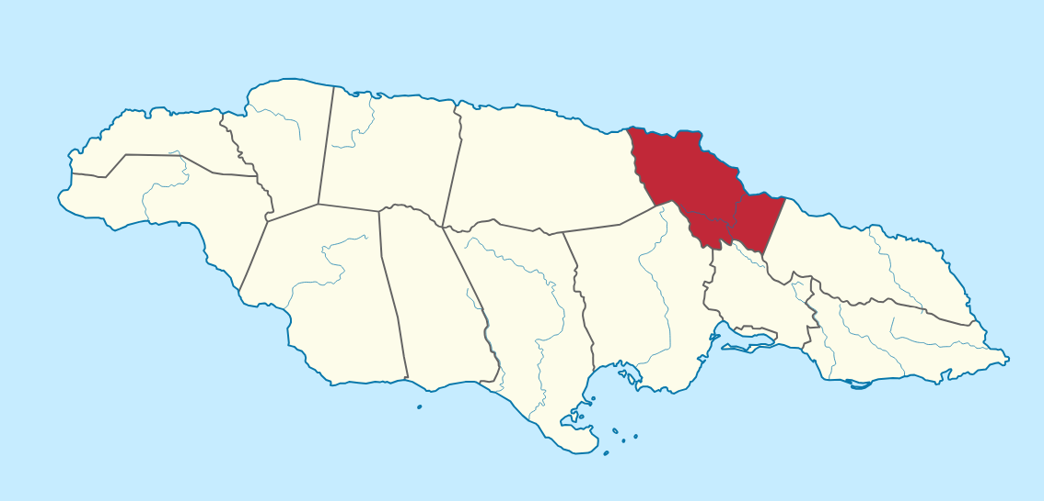
International Day for Monuments and Sites
April 18, 2026
Historical places in St. Mary you need to visit.
Compiled by the Library Unit

Slide 2
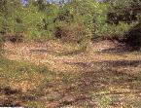
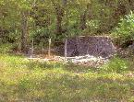
Rio Nuevo Taino Site
Situated along the Rio Nuevo Valley Basin and into the hills as far south as
Bellevue, some ten miles away, is a complex of Taino sites. The largest Taino site
in this area. A view of the eastern section of the Taino site the Rio Nuevo Taino Site, is named after the river that it overlooks. It covers an area of some 21, 000 square metres. B. Jo Stokes who has done extensive research in the area, states that the main road cuts directly through the site separating it into two ownership parcels.
The south portion of the site is owned by the Ocean Ridge Housing Development and has been completely destroyed by heavy machinery over a decade ago when a coconut field was planted. The portion of the site on the north side of the road is owned by George Rose and is relatively intact with the exception of a road, constructed during the 1970s, which cuts through a main portion of the site.
Jamaica National Heritage Trust – Jamaica

Slide 3
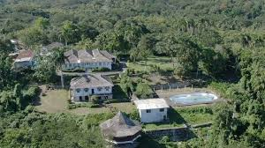

Brimmer Hall Great House
The Bimmmer Hall Great House was built during the
18th Century by the plantocracy during the days of slavery.
The house is a single story building with glass louvre windows and cooler boxes. The structure has high ceilings, polished wooden floors and a wide verandah. The Great House lies on four to five thousand acres of land which was once a part of four adjoining estates: Tryall, Trinity, Roslyn and Brimmer Hall. All of which was owned by
Zachary Bayley.
Great for Field Trips and Family Outings.
https://jnht.com/st_mary.php

Slide 4
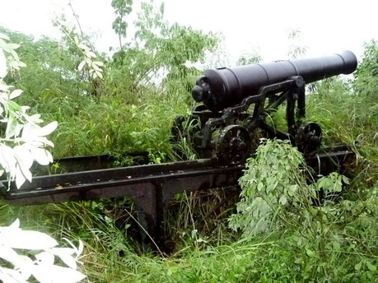
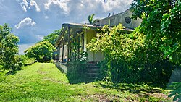
Fort Haldane
This fort was erected in 1759. It was named after General George Haldane, then Governor of Jamaica. The guns of the fort are strategically positioned on a hill facing seaward, which gives a wide and magnificent view of the old shipping port of Port Maria.
Fort Haldane served a pivotal role in Tacky's rebellion, one of Jamaica's bloodiest rebellions against slavery in 1760.
The shipping port was surrounded by sugar estates such as Llanrumney, Trinity, Quebec, Heywood Hall and Frontier.
The two cannons and the ruins of several outbuildings are all that remains of Fort Haldane today.
Read more at: https://en.wikipedia.org/wiki/Fort_Haldane#:~:text=Fort%20Haldane%2 0is%20a%20fortress,Haldane%2C%20then%20Governor%20of%20Jamaica.

Slide 5
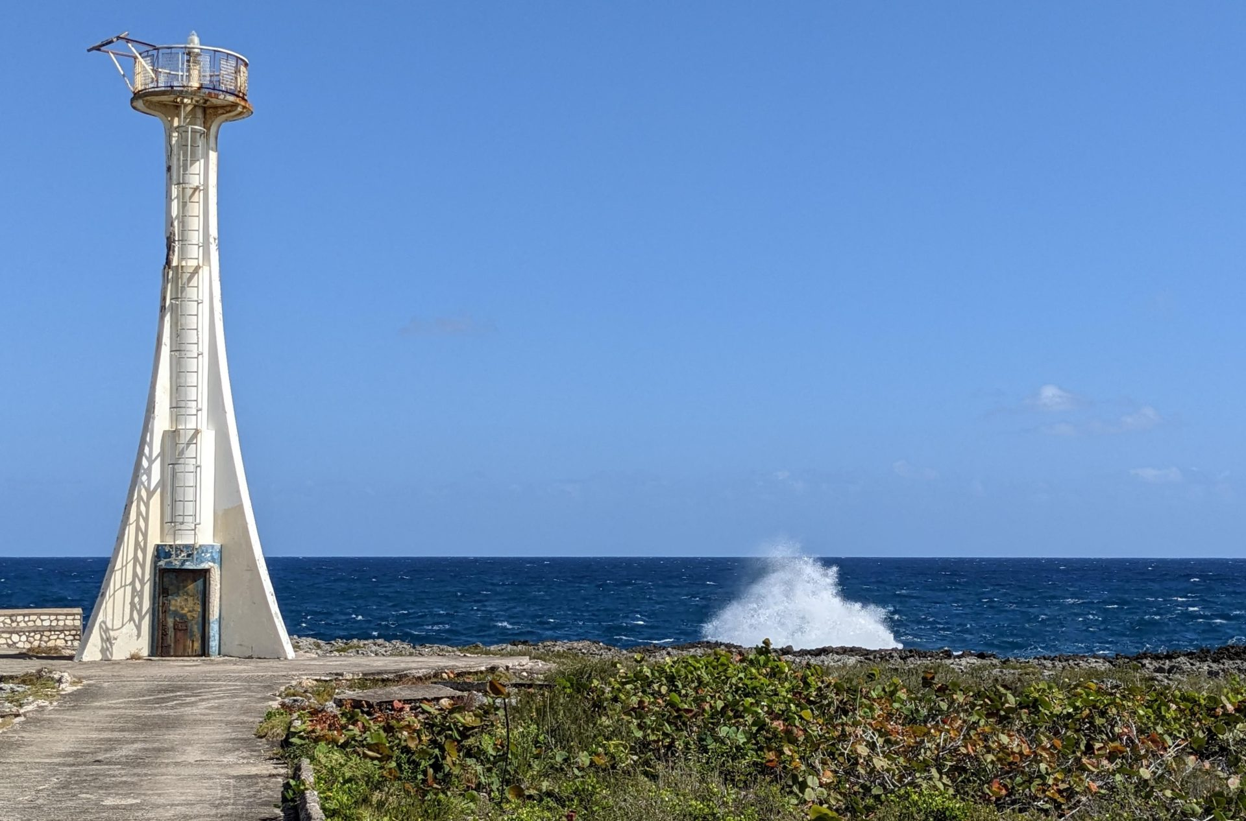
Galina Lighthouse
Near Port Maria, on the North Coast, is the Galina Lighthouse. The Tower which is built of concrete and painted white, is over 40 feet high. The light is approximately 60 feet above sea level. The Lighthouse flashes a white light of 1.2 seconds of duration. This is followed by 10.8 seconds of darkness. Energy for the Lighthouse is solar generated.
The station was established in 1912 but the tower's date of construction is unknown.
It is maintained by the Port Authority of Jamaica, an
agency of the Ministry of Transport and Works.
https://jnht.com/st_mary.php

Slide 6
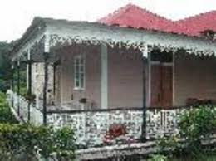
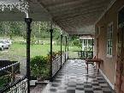
Quebec Great House
The Quebec Great House (Planter's House) structure boasts basic Georgian features, such as symmetry and a central portico. The portico adjoins a wide verandah adorned with cast iron fretwork and balustrade, which goes along the periphery of this area.
The interior of the building is cladded mostly with timber and a very beautiful crystal chandelier is suspended from the ceiling of each main area (i.e. Living and Dining Rooms). Atop the building are three (3) rows of hip roofs.
The other estate buildings though somewhat deteriorated are structurally sound and occupy their original site.
Quebec Great House is a private property.
https://jnht.com/st_mary.php

Slide 7
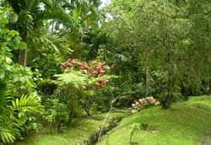
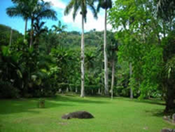
Castleton Botanical Garden
It was established on the 19th November 1862 as a result of dissatisfaction with the site at Bath, St. Thomas. Shortly afterwards, Castleton Gardens became one of the great gardens of the Hemisphere with its rich variety of plants. In the past Castleton had over four (4000) thousand species of plants from the great English Garden at Kew. In 1897 there were one hundred and eighty (180) species of palm in the Palmetum.
Many plants introduced in the island in the late 19th and early 20th centuries were planted here. These included the Poinciana, Bombay Mango, the Spathodea, Navel Orange, and tangerine.
                https://jnht.com/st_mary.php

Slide 8
Woodside
The community of Woodside is one of the Jamaican villages replete with history. It has connection to the Taíno, the plantation era and emancipation. There is evidence of Taíno presence in the area in the form of a prehistoric petroglyph or rock carving site referred to as Dryland, Dry Grounds, Image Cave or “One/Long Bubby Susan”. This petroglyph site was first recorded in 1820 and later published by J.E. Duerden in 1897. As such it is the oldest known petroglyph site on the island. It is located in that part of Woodside called Rock Spring where there is a cave containing this petroglyph.
Like many other indigenous groups, the Taíno used pictographs (rock paintings) and petroglyphs (rock carvings) to communicate and to document aspects of their lives. All of the pictographs and petroglyphs discovered in Jamaica have been found in caves. This is what makes Jamaica unique in comparison with other Caribbean sites.
https://jnht.com/st_mary.php

Slide 9
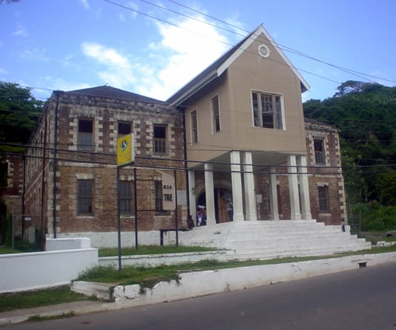
Port Maria Old Court House
The Port Maria Court House is located opposite the
Claude Stuart Park and the Port Maria Parish Church. Originally built in 1821, this fine example of Georgian architecture housed the courthouse and police station until it was gutted by fire in 1988. It was subsequently rebuilt and reopened as the Port Maria Civic Centre in 2000. In the restoration of the building the Urban Development Corporation and the Jamaica National Heritage Trust ensured that structure remained true to the original Georgian style.
https://jnht.com/st_mary.php

Slide 10
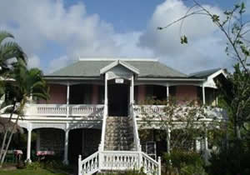
Harmony Hall House
The original property house was on a small pimento estate in the latter
part of the nineteenth century. By 1910, like so many other properties in the parish of St. Mary, Harmony Hall began to plant bananas, and by 1938 the agricultural produce had expanded to include coconuts.
The house became the manse for the local Methodist Church, and the distinguished Sherlock family lived there at one time. The property became the private home of the Lobban family for nearly fifty years. It was sold in 1986, remodelled and subsequently became the Harmony Hall Art Gallery.
The Harmony Hall House was declared a national monument by the Jamaica National Heritage Trust on April 3, 2003.
Location: Situated in Tower Isle, St. Mary, just east of the St. Ann parish border
https://jnht.com/st_mary.php

Slide 11
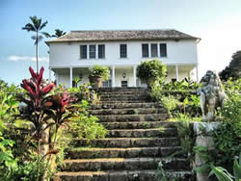
Prospect Great House
On the Prospect Estate is an early Eighteen Century Great House. It has two storeys and possesses some Palladian features. The ground floor is fortified with twenty - eight loopholes that were designed to protect it against marauding pirates and buccaneers.
A mahogany tree in front of the house commemorates the three week stay of Sir Winston Churchill and his family in 1952.
Located in Tower Isle https://jnht.com/st_mary.php

Slide 12
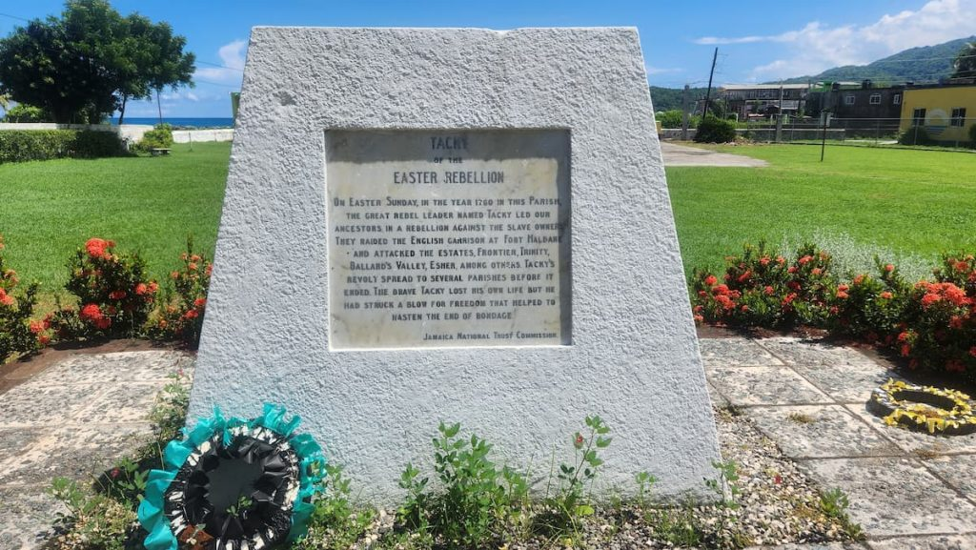
Tacky's Monument
Located at - Claude Stuart Park, Port Maria
Chief Tacky, an Akan warrior from West Africa led the 1760 Easter Rebellion, the first major slave revolt in Jamaica.
Tacky and his followers invaded nearby Fort Haldane and seized weapons to fight against British colonial rule.
The monument stands as a memory of the 1760 uprising, which, although crushed, played a key role in the fight against slavery in Jamaica.
https://jnht.com/st_mary.php

