Slide 1
How to access Mandarin and Online Databases
Step by step

Slide 2
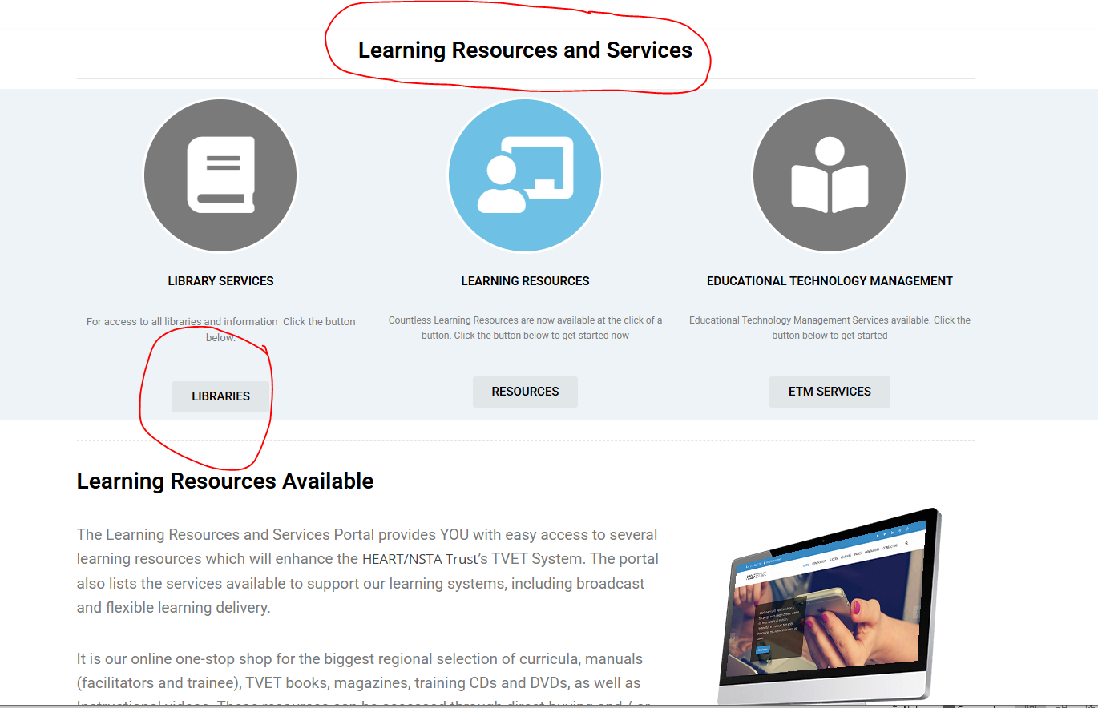
Steps to follow:
Go to the Internet Enter the URL https://learning.heart-nsta.org
Scroll down to Library Resources > click Library Services

Slide 3
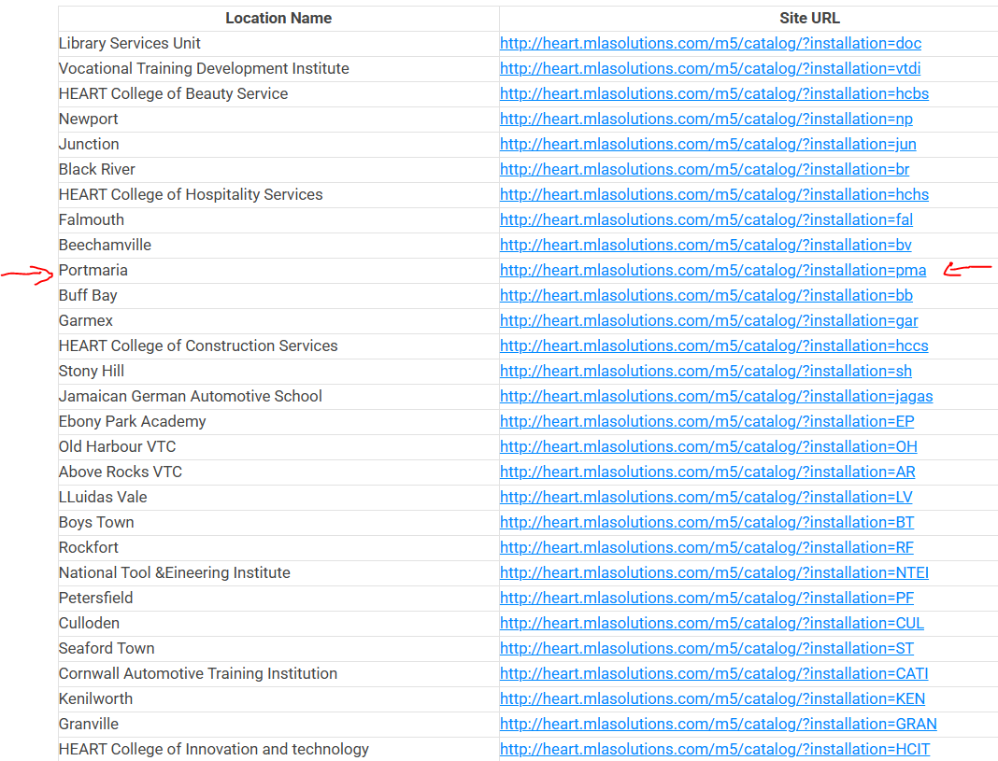
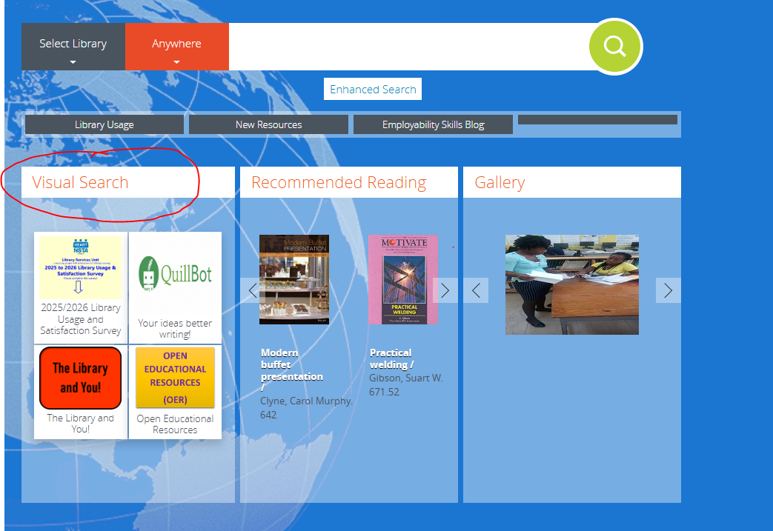
Click on your institution site URL ( Port Maria)
Click Visual Search: Here you will find a list of online resources ( e.g. Online Databases)

Slide 4
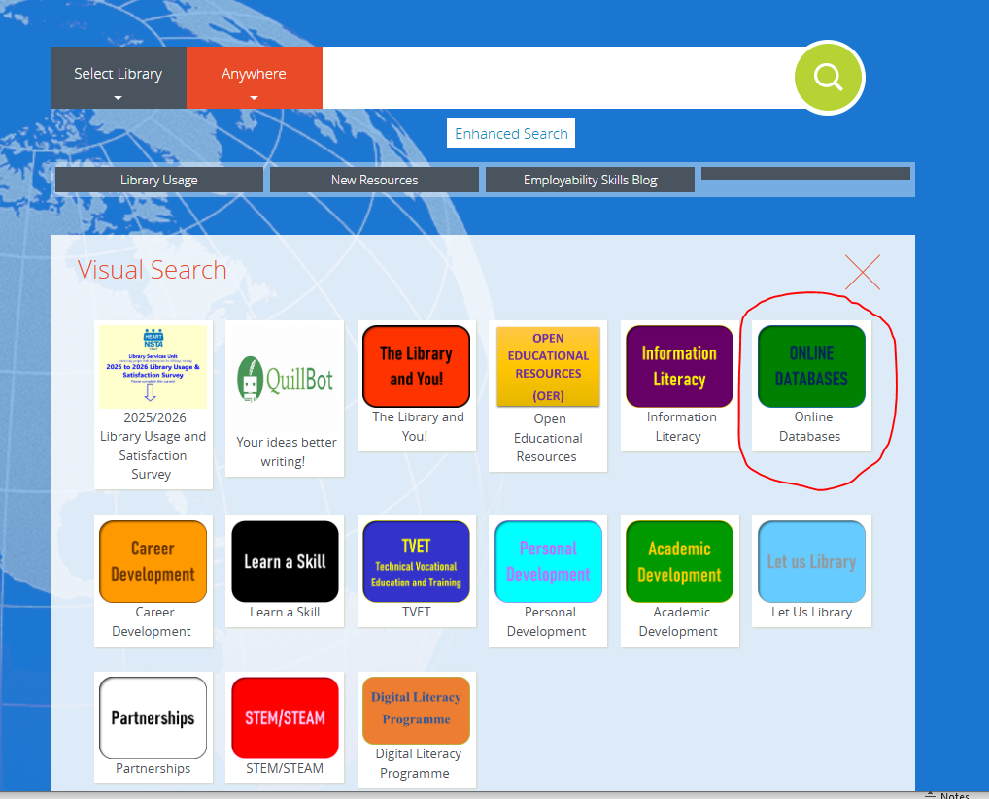
Click Online Databases for a list of accessible databases

Slide 5
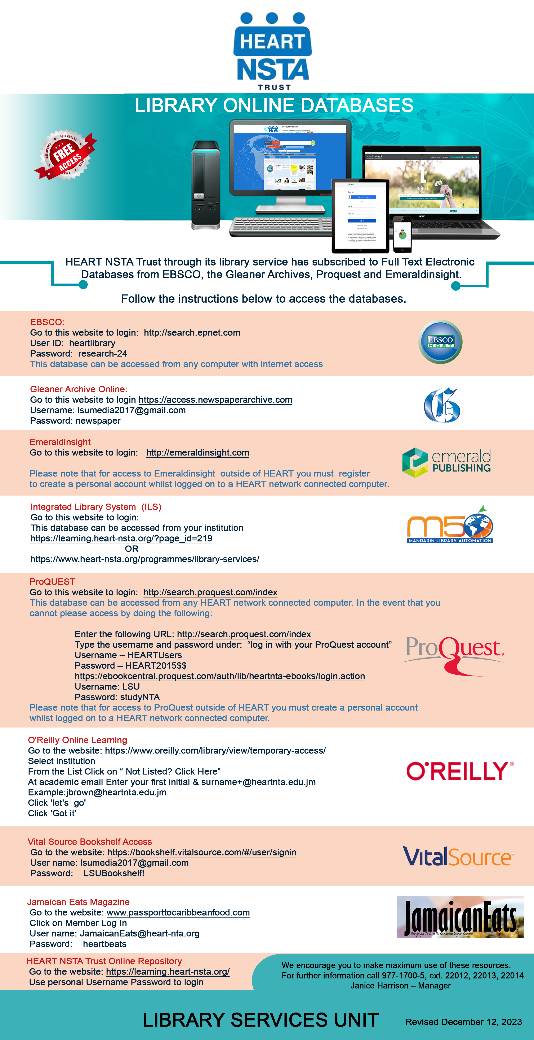
Access requires username and password ( Check the online Database for the following).
This Flyer can be in the Library, on Display Board
Or Moodle Platform.

